Slide 1

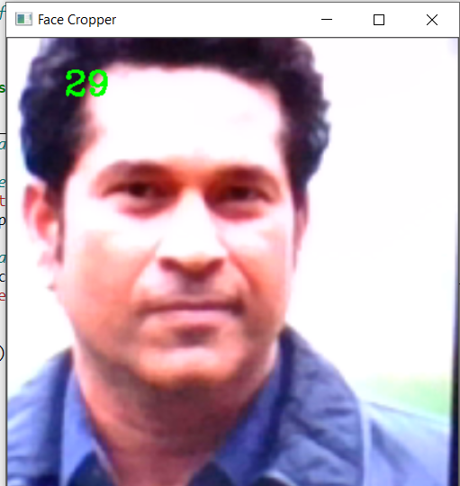
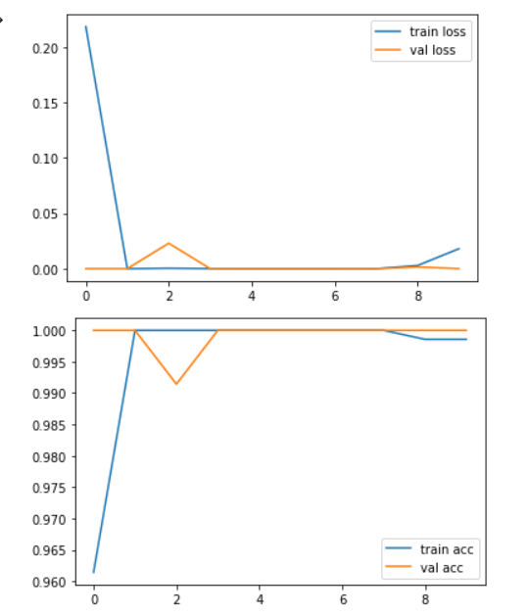
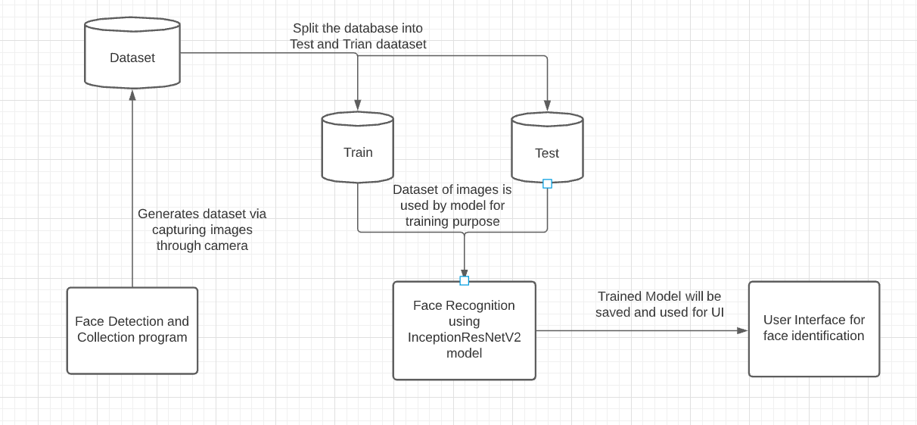
FACE RECOGNITION
DHRUV MITTAL | MANJULA R | SCOPE
Introduction
Results
The research in biometric methods and techniques for recognizing humans supported their behavioral and physical characteristics or traits , face recognition is an inherited trait and it's something that individuals usually perform effortlessly and routinely in their lifestyle and it's the method of identifying individuals from their faces intrinsic characteristics. Automated face recognition has become one of the main targets and objective of investigation for researchers in biometric based systems, pattern recognition, computer vision, and machine learning communities.
While working on this app, our main motive was to help to contribute to the biometrics system based on the human characteristics. We wanted to help the community and institutes with their facial biometrics system which has a much wide application such as attendance system in universities and corporate offices, special usage for cyber forensics team for tracking down the criminals, integration with CCTV cameras for security needs etc. This application is not only limited to security needs and tracking down suspected people, but also can used for any unidentified persons, it could also make it easier to seek out missing children and seniors.
We have successfully created a face detector application which is able to detect a human face from the whole view visible to the web camera, moreover the counter of frames also seems to be perfect which counts how many images have been captured. Like this we have captured a total of 2100 images, 1400 for training and 700 for testing dataset.
As we can see we are able to get training accuracy on average about 99% and validation accuracy average 99%. Even the training and validation loss during the model training has appeared to be very less which is quite good for the model generation.
Figure 2. Face Detection Figure 3. Graphical Accuracy and loss
Motivation
Face recognition makes it easier to track down criminals, thieves and trespassers. The technology is could also be integrated in CCTV cameras for surveillance purposes and monitoring. This type of prototype can also be used in work places and even in universities for attendance systems where it would recognize faces and automatically mark attendance of an individual. Since this process is faster than traditional roll call systems it saves much time and employees don’t have to prove their identities or clock in with pastic cards.
SCOPE of the Project
We will using the Transfer Learning technique called InceptionResNetV2 provided by the Keras library. InceptionResNetV2 is a CNN technique that is trained on more than a million images from the ImageNet database. We have different modules in this project such as Face Detection along with dataset creation and Face Recognition using Transfer Learning technique. It involves two main steps. First to detect the face of a person and identify the distinguishing factors in image and storing them and second step to compare it with the existing images and returning the data related to that image.
Methodology
We are intending to actualize Transfer Learning technique to get the best and most effective outcomes. This calculation isn't commonly utilized in biometric system services as per our exploration we can utilize it to achieve the best results.
Our project aims on building a face recognition system which will be able to identify the persons in front of the camera with their identity. If we compare to traditional machine learning algorithms and techniques, deep learning algorithms have shown much better results in accuracy and speed of processing in image recognition.
Our methodology is first to collect the images as dataset, which we will be doing Face detector program using OpenCV which captures the faces detected and store it desired location and then classify the dataset into training and testing dataset. Once we complete our image collection for dataset, we can use this dataset to for Face recognition program which will generate a model and tell us the accuracy of the proposed model. After that, we use an interface which will capture image in front of camera and reveal the identity of the person. This is how are face recognition system will work.
Figure 1. Proposed System Model
Conclusion
This application of face recognition is a general prototype for a wide variety of applications in several professional industries. This project is a minor step towards achieving a bigger target of Face recognition and advancement in biometric security systems. A lot more work can be done to further improve our initiative in this regard such as an automated application which would take input name of the end user and start detecting the faces and capture them into the dataset inside the folder with the users name on it. We can also do something related to cyber security in here to add a protection over the dataset for privacy of individuals and prevent data breaching.
References
Papageorgiou, C., Oren, M., and Poggio, T. 1998. A general framework for object detection. In International Conference on Computer Vision.
Image-based Face Detection and Recognition: “State of the Art” Faizan Ahmad , Aaima Najam and Zeeshan Ahmed.
Human face detection algorithm via Haar cascade classifier combined with three additional classifiers: Li Cuimei , Qi Zhiliang , Jia Nan , Wu Jianhua .
Samiksha Malhotra1 *, Vaibhav Aggarwal 1 , Himanshu Mangal 1 , Preeti Nagrath 1 and Rachna Jain1 1Department of CSE, Bharati Vidyapeeth’s College Of engineering New Delhi, India.
Illumination-robust face recognition based on deep convolutional neural networks architectures Ridha Ilyas Bendjillali1 , Mohammed Beladgham2 Khaled Merit3 , Abdelmalik Taleb-Ahmed4

